Slide 1
MARKETING INNOVATION & AI GOVERNANCE
Innovation &
Validation Framework
Built on Nail It Then Scale It — to enable and accelerate our AI innovation culture
Marv Ahlstrom · January 2026

Slide 2
The problem we're solving
Marketing teams are inundated with ideas. We need to focus on those that deserve to ship.
Solution-shaped ideas
Brand & data risk
"Let's use AI to do X" — without anchoring to a real customer pain or business outcome.
Customer-facing AI shipped without governance creates compounding risk that's hard to walk back.
Effort waste
No common language
Teams spend cycles on prototypes that aren't aligned to strategic priorities — and don't get adopted.
Without a shared methodology, every team validates differently and leadership can't compare ideas.
AI Governance · Innovation & Validation Framework
Why this matters

Slide 3
The objective
A disciplined, repeatable approach that turns every employee into a value multiplier.
OBJECTIVE
Help marketing employees develop applications, platforms, and capabilities that simplify work, accelerate execution, and enable new ways of operating for all stakeholders — through disciplined, repeatable methods rooted in validated innovation.
Aligned
Validated
Governed
Every AI idea ties to a strategic priority.
Every idea proves a real pain before scaling.
Every shipped output respects brand, data, and trust.
AI Governance · Innovation & Validation Framework
Objective

Slide 4
The three-step framework
Train. Align. Build. In that order — every time.
1
2
3
Foundational Training
Strategic Alignment
Hackathon Pipeline
NISI + Big Idea Canvas
Mentor + AI Agent Review
Build, Test, Pilot
Equip every employee with the language and lenses to evaluate AI ideas before pitching them.
Each idea is reviewed against AI ethics and the SLT strategic priorities before it can move forward.
Validated ideas enter a structured hackathon — winning concepts move to product planning or pilots.
AI Governance · Innovation & Validation Framework
The Framework

Slide 5
STEP 1
Foundational Training
01
Focus efforts on customer pain. Build a common innovation language.

Slide 6
Two methodologies, one mindset
NISI gives the validation rigor. The Big Idea Canvas gives the ideation structure.
METHODOLOGY 1
METHODOLOGY 2
Nail It Then Scale It
Big Idea Canvas
(NISI)
(BIC)
Teaches employees to:
Five lenses, every idea:
Identify monetizable customer pain
Rapidly test hypotheses
Build lean prototypes before scaling
Pain · Potential · Prescription
Positioning · Path to the Exit
(See next slide for the marketing lens)
AI Governance · Innovation & Validation Framework
Step 1 · Methodologies

Slide 7
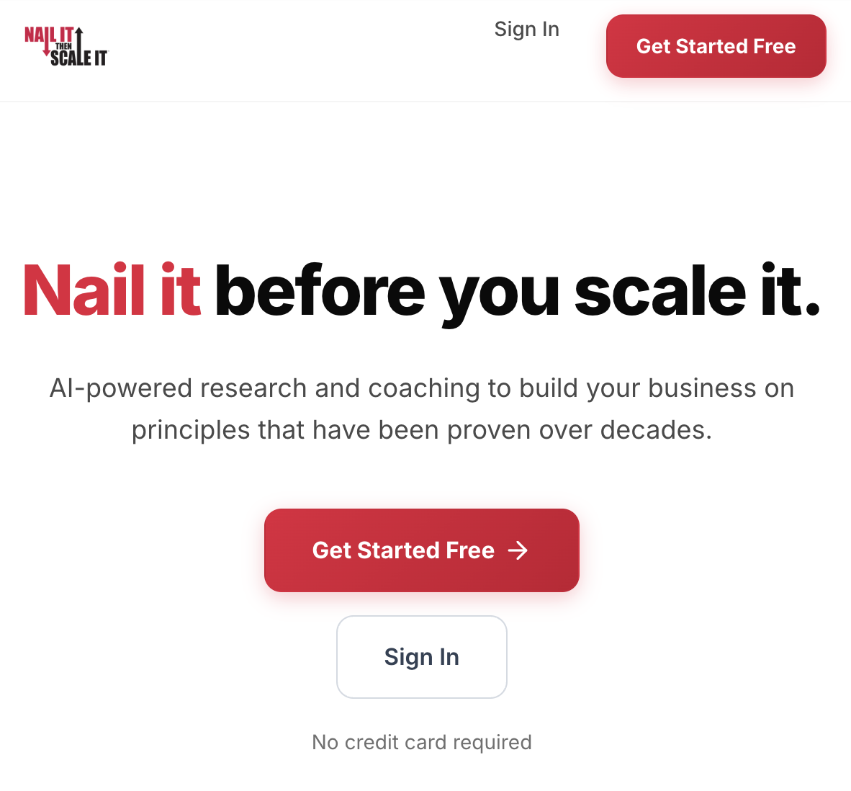
NISI Launch
NISI in 4 phases
Nail before you scale. Each phase has a question — and a pivot-or-proceed decision.
PHASE 1
PHASE 2
PHASE 3
PHASE 4
Nail the Pain
Nail the Solution
Nail the GTM
Nail the Model
Is the pain real, frequent, monetizable?
Does our MVP actually solve it?
Will customers adopt and trust it?
Does value clearly exceed cost & risk?
→ THEN scale it. Don't scale what you haven't nailed.
AI Governance · Innovation & Validation Framework
Step 1 · NISI

Slide 8
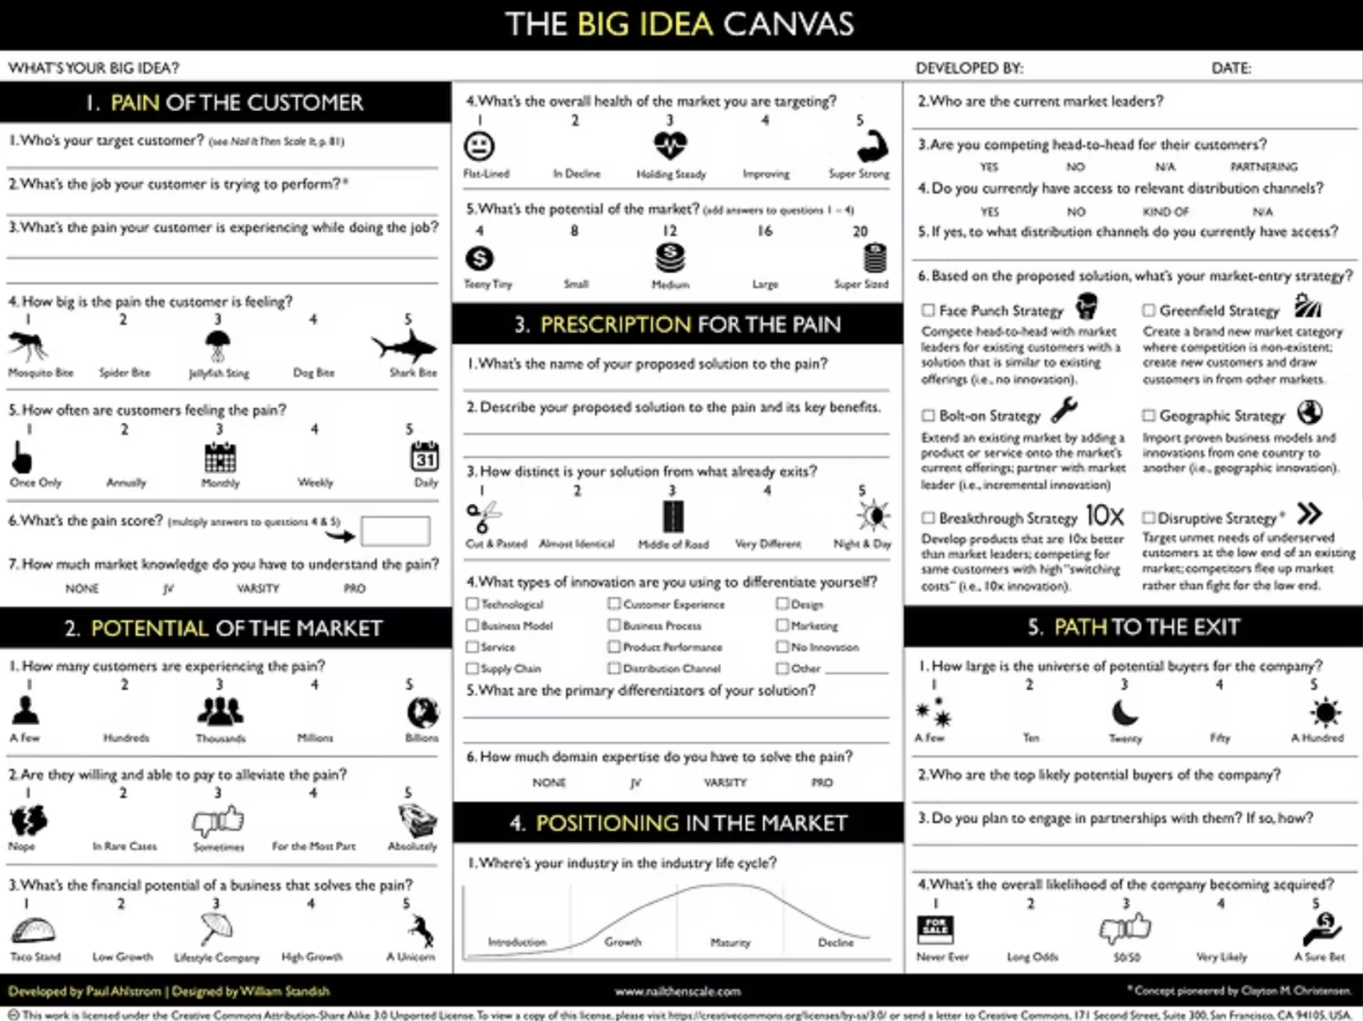
The Big Idea Canvas — five P's, one worksheet
Every AI enabled idea pitched must answer all five.
P1
P2
P3
P4
P5
Pain
Potential
Prescription
Positioning
Path
of the Customer
of the Market
for the Pain
in the Market
to the Exit
Whose pain? How severe? How often?
How big? Growing? Reachable?
How does our AI idea solve it?
Why us, why now, vs. what else?
How does this win — for the business?
AI Governance · Innovation & Validation Framework
Step 1 · The 5 P's

Slide 9
The 5 P's through a marketing lens
What "good answers" sound like when the AI idea is for a marketing campaign or workflow.
LENS
MARKETING-SPECIFIC QUESTIONS
Pain
Whose marketing job hurts? Buyer, SDR, content lead, ops? What evidence: cycle time, revisions, drop-off, complaints, NPS?
Potential
How many campaigns / accounts / segments would benefit? What's the volume × value of the workflow today?
Prescription
Which AI capability solves it — content, collaboration, automation, data/research, or personalization (Liza's 5 categories)?
Positioning
Why is this better than the human-only path or existing tools? What does the agent uniquely change?
Path
How does this affect pipeline, conversion, retention, brand, or speed-to-market? What's the business case?
AI Governance · Innovation & Validation Framework
Step 1 · Marketing Lens

Slide 10
Training modality + Step 1 outcome
Virtual, AI-assisted, completed before any hackathon submission.
HOW IT'S DELIVERED
OUTCOME
Virtual modules — self-paced, completed pre-hackathon
AI-assisted — built using the same agentic tools employees will use
Built around real marketing scenarios
Includes practical Big Idea Canvas exercises
Completion tracked — gates hackathon submission
Refreshed annually as AI capabilities evolve
A workforce that speaks a common innovation language.
Equipped to work smarter with AI — not just harder.
AI Governance · Innovation & Validation Framework
Step 1 · Training & Outcome

Slide 11
STEP 2
Strategic Alignment Checkpoint
02
Mentor-led review against AI ethics and SLT priorities — before anything is built.

Slide 12
Three review questions — every idea, every time
Mentors and an AI agent walk each idea through these. Pass all three to advance.
Does it align with our AI principles?
1
Responsible use, simplification of operations, transparency. Anything that violates these stops here.
Does it apply AI meaningfully?
2
Increase efficiency, scale insights, or personalize engagement. Not 'AI for AI's sake.'
Does it support an SLT priority?
3
Maps clearly to one or more strategic priorities. (Detailed on the next slide.)
AI Governance · Innovation & Validation Framework
Step 2 · Review

Slide 13
The 6 SLT strategic priorities
Every AI idea must support at least one. Most great ideas support two or three.
PRIORITY 1
PRIORITY 2
PRIORITY 3
Execution & Integration
Product Leadership
Working Smarter with AI
PRIORITY 4
PRIORITY 5
PRIORITY 6
Empowering People & Customers
Customer Engagement at Scale
Strengthening Trust & Relationships
AI Governance · Innovation & Validation Framework
Step 2 · Priorities

Slide 14
How marketing contributes to each priority
Use this map to position any marketing AI idea against the right strategic priority.
SLT PRIORITY
WHAT MARKETING AI CAN UNLOCK
Execution & Integration
Faster campaign cycles · cleaner cross-functional handoffs · automated brief-to-asset pipelines
Product Leadership
Customer research synthesis at scale · sharper voice-of-customer insights feeding product
Working Smarter with AI
Agent-augmented teams · workflow automation · evaluation rubrics for AI outputs
Empowering People & Customers
AI as teammate, not replacement · training that levels up the team's craft
Customer Engagement at Scale
Personalization across segments · lifecycle messaging · ABM at scale
Strengthening Trust & Relationships
Brand voice QA · responsible disclosure · grounded customer-facing content
AI Governance · Innovation & Validation Framework
Step 2 · Marketing Map

Slide 15
The mentor & reviewer model
Internal mentors + an AI review agent screen ideas before hackathon submission.
AI Review Agent
Functional Mentor
First-pass screen — runs the 3 alignment questions and the 5 P's. Flags risks. Routes to a human mentor.
Marketing leader who validates the pain, the prescription, and the brand fit. One per submission.
Cross-functional Reviewer
SLT Sponsor
Legal/IT/data partner who flags governance issues — privacy, claims, regulated data, IP.
Greenlights the idea for hackathon and connects to a strategic priority.
Outcome: a portfolio of validated, high-potential ideas — already aligned to the business.
AI Governance · Innovation & Validation Framework
Step 2 · Reviewers

Slide 16
STEP 3
Apply to Innovation Pipeline
03
Build, test, pilot. Validated ideas become real prototypes
— and product roadmap candidates.

Slide 17
Ideation structure
A repeatable cadence — same shape every time, so teams know how to prepare.
1
Submission
Trained employees submit a Big Idea Canvas + alignment statement.
Week 1
2
Team formation
Cross-functional teams form around greenlit ideas.
Week 2
3
Build sprint
Teams build a functional prototype or conceptual demo with mentor support.
Weeks 3–4
4
Demo day
10-min team pitches to executive sponsors and judges.
Week 5
5
Pilot decision
Top ideas advance to product planning or internal pilots.
Week 6
AI Governance · Innovation & Validation Framework
Step 3 · Hackathon

Slide 18
Verification criteria
Scored across five dimensions. The Big Idea Canvas + the agentic execution + governance.
Pain Validation
Evidence the customer pain is real, frequent, and quantifiable.
20%
Solution Quality
Does the AI prototype actually solve the pain — and demo well?
25%
Strategic Alignment
Clear linkage to one or more SLT priorities.
15%
Governance Maturity
Brand fit, privacy, claims, audit trail — addressed up front.
20%
Path to Pilot
Realistic plan to scale: who, where, with what guardrails.
20%
AI Governance · Innovation & Validation Framework
Step 3 · Judging

Slide 19
What happens after demo day
Top solutions enter product planning or internal pilot tracks — with continued mentorship.
TRACK 1
TRACK 2
TRACK 3
Product Roadmap Track
Internal Pilot Track
Backlog or Iterate
Top scoring ideas tied to product opportunities are pitched to product leadership for inclusion in roadmap planning.
Internal-facing ideas (operations, content, research) move to a 30-90 day pilot with a real team and success metrics.
Promising-but-unready ideas return to the Canvas with clear feedback. Teams can resubmit at the next hackathon.
→ Owners assigned, scoping begins
→ Pilot lead + sponsor named
→ Mentor coaching continues
AI Governance · Innovation & Validation Framework
Step 3 · Post-Hackathon

Slide 20
Marketing hackathon idea seeds
Five categories, two seed ideas each — a starting point for teams who don't know where to begin.
Content
Collaboration
Automation
Data / Research
Personalization
SEED IDEAS
SEED IDEAS
SEED IDEAS
SEED IDEAS
SEED IDEAS
· AI search visibility workflow
· Brief-to-asset pipeline
· Campaign QA & compliance
· Customer review → POV post
· Persona-specific email variants
· Brand-voice editor agent
· Meeting-to-action agent
· Asset naming & tagging
· Competitor monitor
· Lifecycle nudge writer
Source: Liza Adams' 5 marketing categories. Teams pick a category, then a seed — or bring their own.
AI Governance · Innovation & Validation Framework
Step 3 · Idea Seeds

Slide 21
Marketing AI red lines
Some things never ship without explicit, documented approval — even if the demo wins.
⊘
Customer-facing content auto-published without human review
⊘
Sensitive customer data (PII, financial) used in third-party tools
⊘
Comparative claims about competitors without legal sign-off
⊘
Synthetic voices, faces, or testimonials representing real people
⊘
Personalization that uses inferred protected attributes
⊘
Automated outbound to net-new contacts without consent
⊘
Pricing or SLA claims generated by AI without human verification
⊘
Brand-sensitive output without brand QA in the loop
AI Governance · Innovation & Validation Framework
Step 3 · Red Lines

Slide 22
What this framework delivers
Four corporate goals — measurable, defensible, leadership-ready.
Reduce Innovation Risk
Accelerate AI Adoption
AI efforts grounded in validated need and tied to measurable ROI before they scale.
Every employee trained to think and work with AI effectively — common language, common method.
Increase Strategic Alignment
Create a Scalable Model
All AI activity maps directly to top-level business priorities, not pet projects.
Repeatable, embeddable into culture and operations — runs hackathon after hackathon.
AI Governance · Innovation & Validation Framework
Goals

Slide 23
Suggested rollout — first 90 days
Move deliberately. Get the framework right with marketing first, then scale across functions.
Days 1–30
Days 31–60
Days 61–90
Foundations
First cohort
First hackathon
Stand up training modules
Recruit first cohort of mentors
Define AI principles & red lines
Identify SLT sponsors
First 50 marketers complete training
Pilot the alignment review process
Refine the Big Idea Canvas template
Run a small-scale ideation event
Run first marketing hackathon
5-week cycle, end-to-end
Greenlight 1–3 ideas to pilot
Document lessons; plan cohort 2
AI Governance · Innovation & Validation Framework
Rollout · 90 Days

Slide 24
The outcome we're after
A culture of validated, employee-driven AI innovation — democratized, strategic, transformative.
THE WIN
Every employee becomes a value multiplier — for customers, partners, and the business.
Democratized
Strategic
Transformative
AI capability lives in every team, not just a center of excellence.
Every AI initiative is tied to a real customer pain and a business priority.
AI changes how we work — not just what we ship.
AI Governance · Innovation & Validation Framework
Outcome

Slide 25
WHAT WE'RE ASKING FOR
Endorse the Framework
Sponsor the first marketing hackathon.
Endorse
Sponsor
Show up
The 3-step framework as our marketing AI standard.
The first 90-day cohort + hackathon — name an SLT lead.
Be a judge on demo day. Visibility unlocks adoption.

